Slide 1

Understanding the Different Versions of Angular
Before we dive into the differences, let’s first clarify each version with a description:
AngularJS is an open-source, JavaScript-based, front-end web application framework for dynamic web app development. It utilizes HTML as a template language. By extending HTML attributes with directives and binding data to HTML with expressions, AngularJS creates an environment that is readable, extraordinarily expressive and quick to develop.
Angular is the blanket term used to refer to Angular 2, 4, 6 , 7 and all other versions that come after AngularJS. All Angular are open-source, TypeScript-based front-end web application platforms.
Angular 4 is the latest version of Angular. Although Angular 2 was a complete rewrite of AngularJS, there are no major differences between Angular 2 and above in the fundamentals. Only an improvement and is backward compatible with Angular versions.

Slide 2
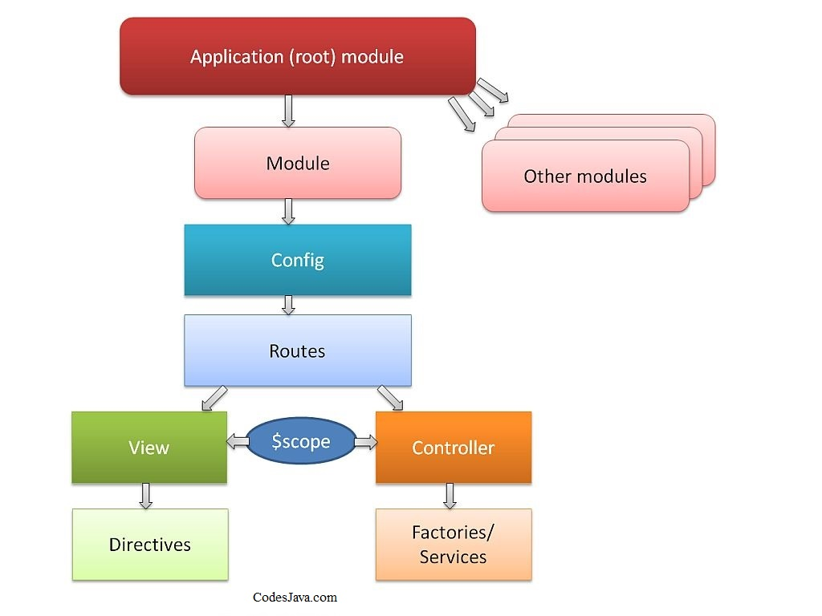
Architecture
AngularJS
The architecture of AngularJS is based on model-view-controller (MVC) design. The model is the central component that expresses the application's behavior and manages its data, logic, and rules. The view generates an output based on the information in the model. The controller accepts input, converts it into commands and sends the commands to the model and the view.

Slide 3
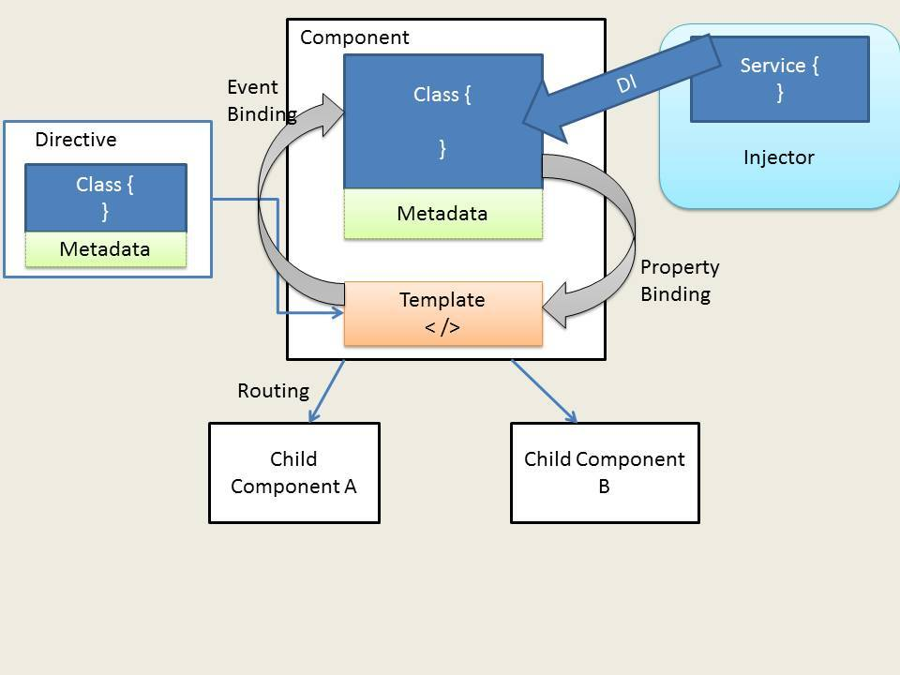
Angular
In Angular 2+, controllers and $scope were replaced by components and directives. Components are directives with a template. They deal with a view of the application and logic on the page. There are two kinds of directives in Angular 2. These are structural directives that alter the layout of the DOM by removing and replacing its elements, and attributive directives that change the behavior or appearance of a DOM element.
In Angular 4+, the structural derivatives ngIf and ngFor have been improved, and you can use if/else design syntax in your templates.

Slide 4
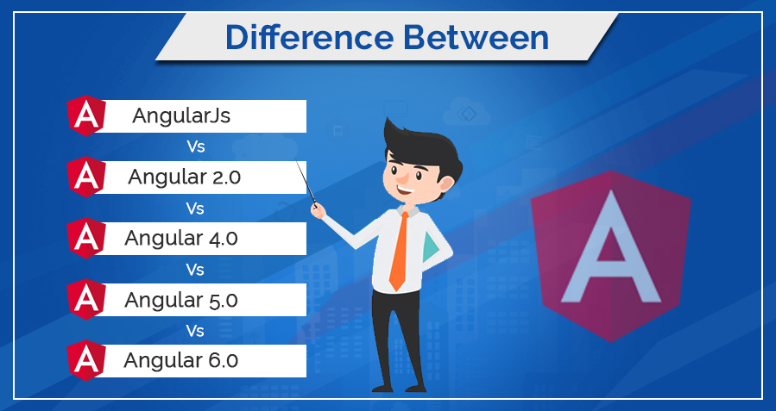
2. Language
AngularJS
AngularJS is written in JavaScript.
Angular
Angular uses Microsoft’s TypeScript language, which is a superset of ECMAScript 6 (ES6). This has the combined advantages of the TypeScript features, like type declarations, and the benefits of ES6, like iterators and lambdas.
Angular 2+ is compatible with the most recent versions of TypeScript that have powerful type checking and object-oriented features.
3. Mobile Support
AngularJS was not built with mobile support in mind, but Angular 2 + all versions feature mobile support.

Slide 5
2. Language
AngularJS
AngularJS is written in JavaScript.
Angular
Angular uses Microsoft’s TypeScript language, which is a superset of ECMAScript 6 (ES6). This has the combined advantages of the TypeScript features, like type declarations, and the benefits of ES6, like iterators and lambdas.
Angular 2+ is compatible with the most recent versions of TypeScript that have powerful type checking and object-oriented features.
3. Mobile Support
AngularJS was not built with mobile support in mind, but Angular 2 + all versions feature mobile support.

Slide 6


4. Performance
AngularJS was originally developed for designers, not developers. Although there were a few evolutionary improvements in its design, they were not enough to fulfill developer requirements. The later versions, Angular 2+, have been upgraded to provide an overall improvement in performance, especially in speed and dependency injection.
1. Speed
By providing features like 2-way binding, AngularJS reduced the development effort and time. However, by creating more processing on the client side, page load was taking considerable time. Angular2 provides a better structure to more easily create and maintain big applications and a better change detection mechanism. Angular 4 is the fastest version yet.
2. Dependency injection
Angular implements unidirectional tree-based change detection and uses Hierarchical Dependency Injection system. This significantly boosts performance for the framework.

Slide 7


Advantages and Disadvantages
Angular 2+
Advantages
TypeScript allows code optimization using the OOPS concept.
It is mobile-oriented.
It has improved dependency injection and modularity.
It provides more choice for languages such as Dart, TypeScript, ES5, and ES6 for writing codes.
It offers simpler routing.

Slide 8
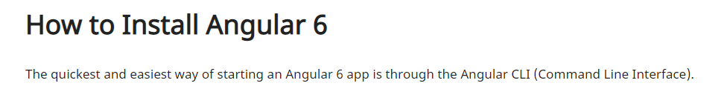
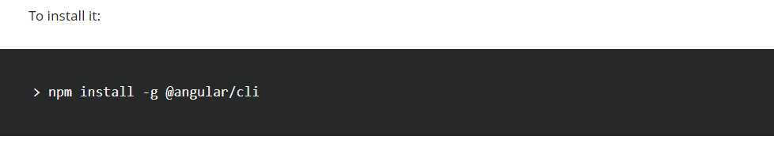
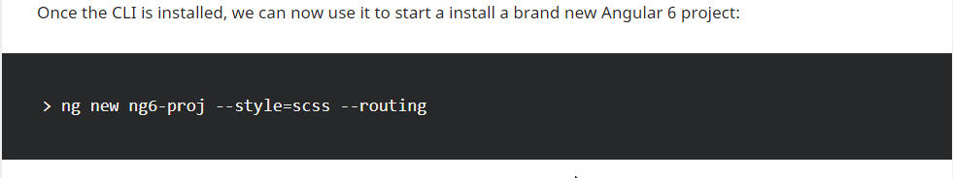

Slide 9
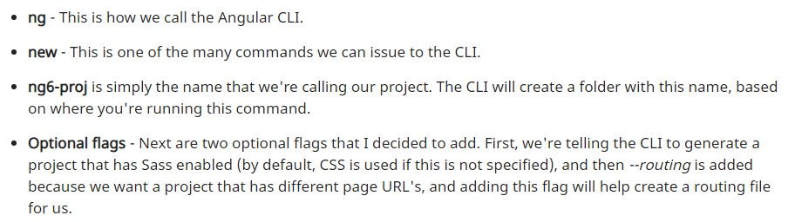
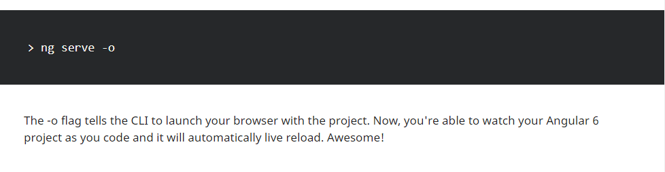

Slide 10
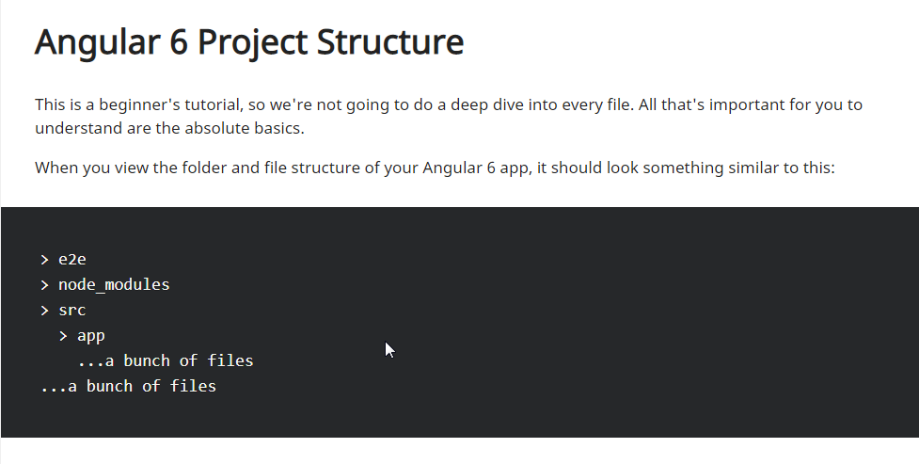

Slide 11
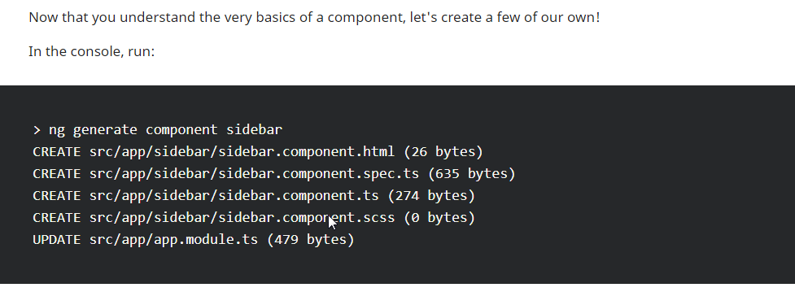

Slide 12
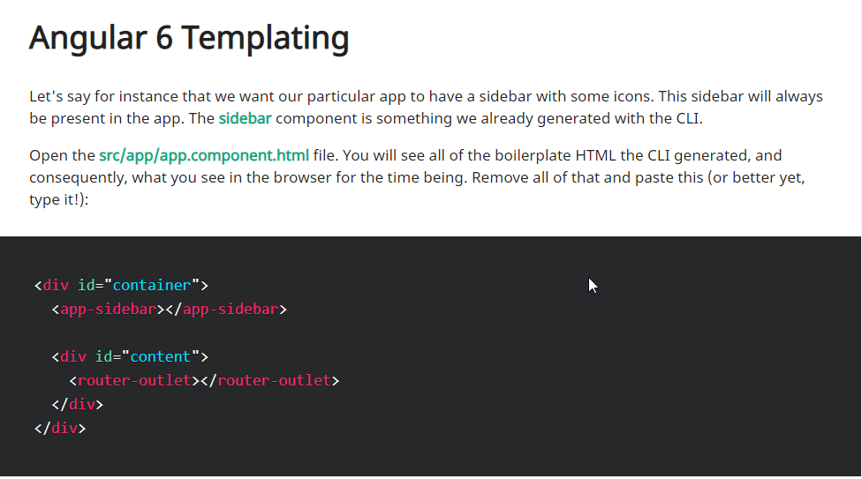

Slide 13





Slide 14


